Slide 1
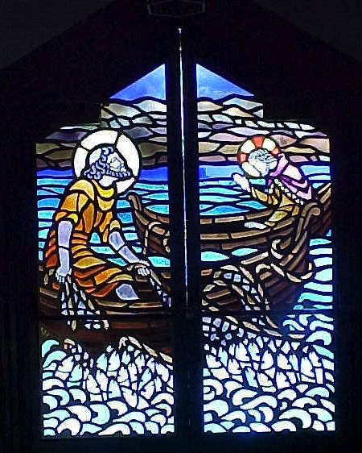
When You Really Mess Things Up…
A Study of John 21
Dr. Rick Griffith • Crossroads International Church Singapore cicfamily.com & BibleStudyDownloads.org

Slide 2
One day at ICS…

Slide 3
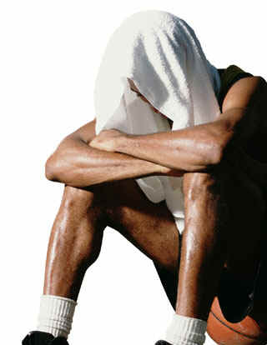
Have you failed?
?

Slide 4
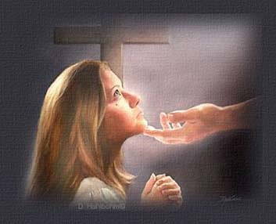
How does Jesus restore us after we really mess things up?

Slide 5
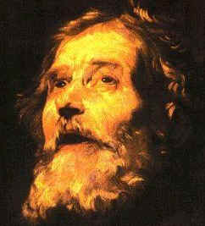
A Regretful Peter

Slide 6
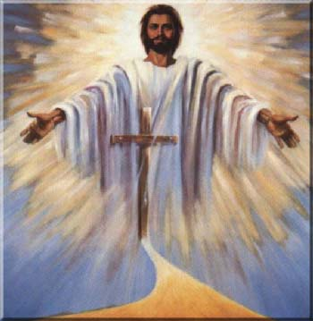
A Resurrected Savior

Slide 7
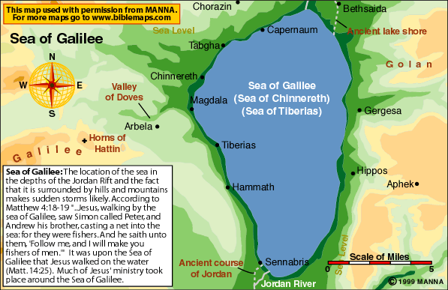
The Sea of Tiberias (John 21)

Slide 8
Movements
3 ways that Christ restores us after failure
Miraculous catch
Peter's Reinstatement
John's Death
Conclusion

Slide 9
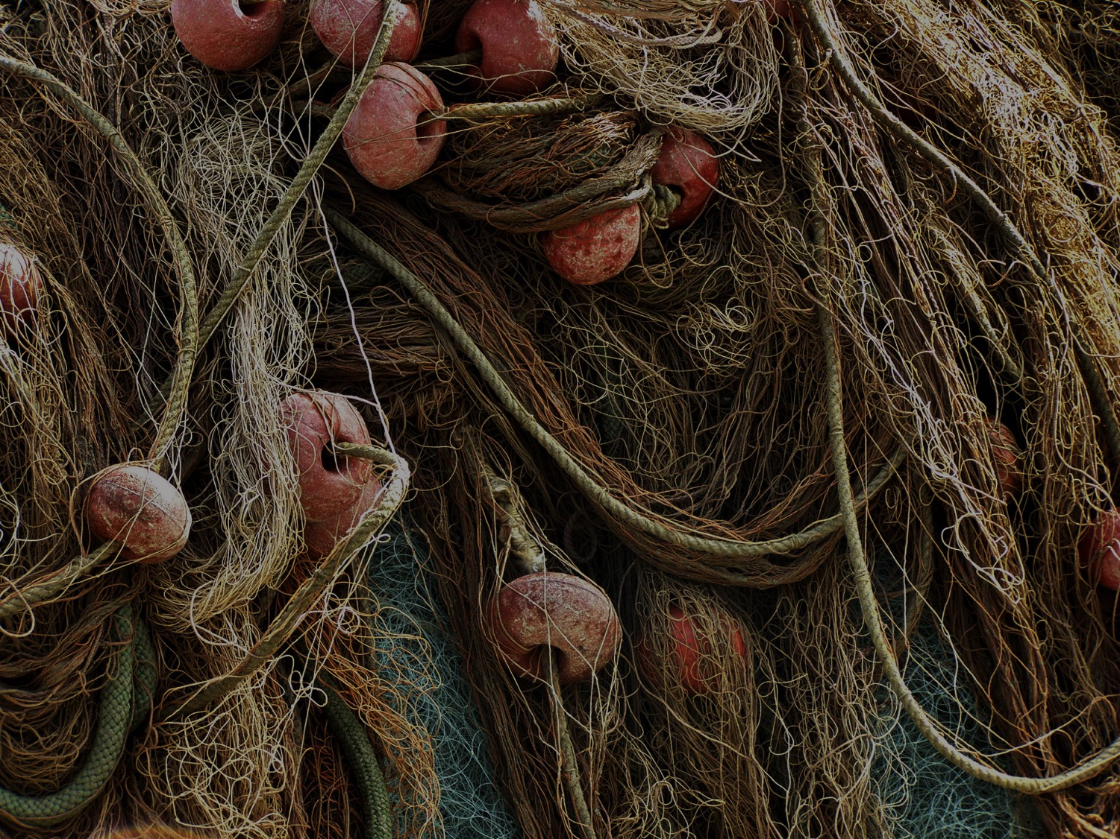
I. Admit you need Christ even where you feel competent (21:1-14).

Slide 10
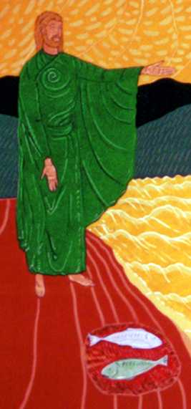
“Have you caught anything?”
Notes:
http://perso.wanadoo.fr/saint.pierre/pagesan/alapparition_au_lac.html

Slide 11
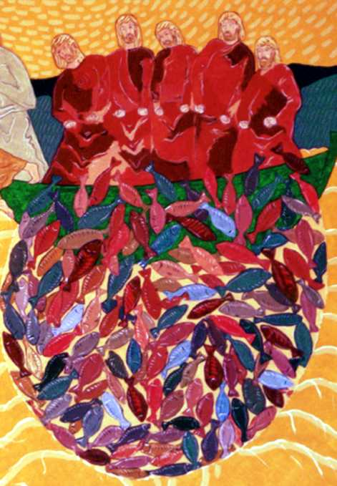
“No.” “Cast your net on the right side.” “Whoa!”
Notes:
http://perso.wanadoo.fr/saint.pierre/pagesan/alapparition_au_lac.html

Slide 12
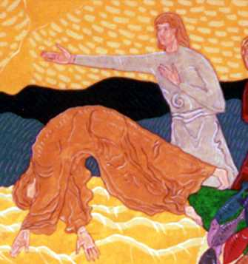
John: “It's the Lord!” Peter: “Jump!”
Notes:
http://perso.wanadoo.fr/saint.pierre/pagesan/alapparition_au_lac.html

Slide 13
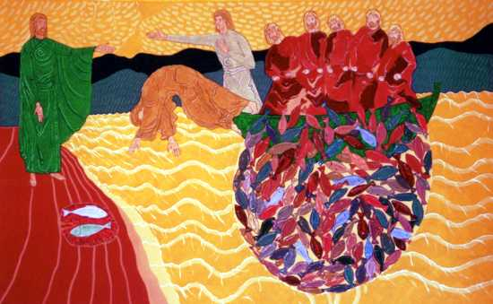
What's the point of this miracle?
Notes:
http://perso.wanadoo.fr/saint.pierre/pagesan/alapparition_au_lac.html

Slide 14
Fish Déjà Vu
Is John alluding to the earlier account?
Luke 5:1-11
John 21:1-14
Calling
Reinstatement
Jesus in boat
Jesus on shore
“Follow me”
“Feed my lambs”
Evangelize
Shepherd
Jesus' Message Repeated: “You need me to be truly competent!”

Slide 15
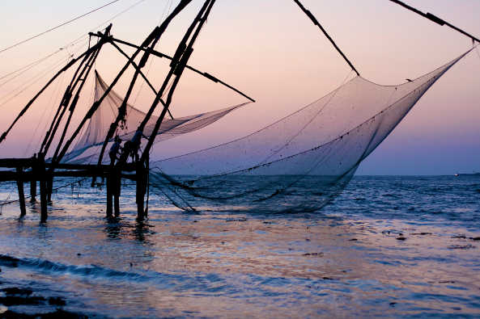
Do you admit that you need Christ even in your area of competence?
Notes:
http://perso.wanadoo.fr/saint.pierre/pagesan/alapparition_au_lac.html

Slide 16
“Have you sold anything?” "No, Lord"
Notes:
http://perso.wanadoo.fr/saint.pierre/pagesan/alapparition_au_lac.html

Slide 17
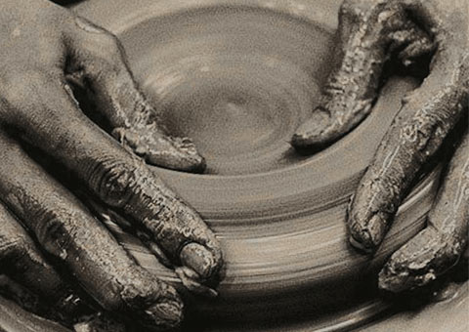
What's your area of competence?

Slide 18
I. Admit you need Christ even where you feel competent (21:1-14).

Slide 19
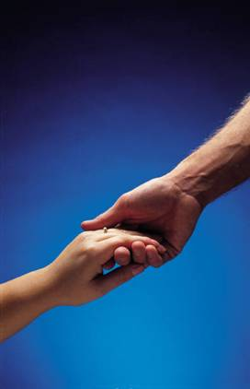
II. Show your love for Christ by loving people (21:15-17).

Slide 20
“Do you love me more than these?”
What are “these”?
“Do you love me more than you love fishing?”
“Do you love me more than you love these disciples?”
“Do you love me more than the rest of these disciples love me?”
Notes:
John 13:37 “I will lay down my life you” (even if the others fail you)

Slide 21
Three Questions
Do you agape me?
I phileo you.
Do you agape me?
I phileo you.
Do you phileo me?
I phileo you.

Slide 22
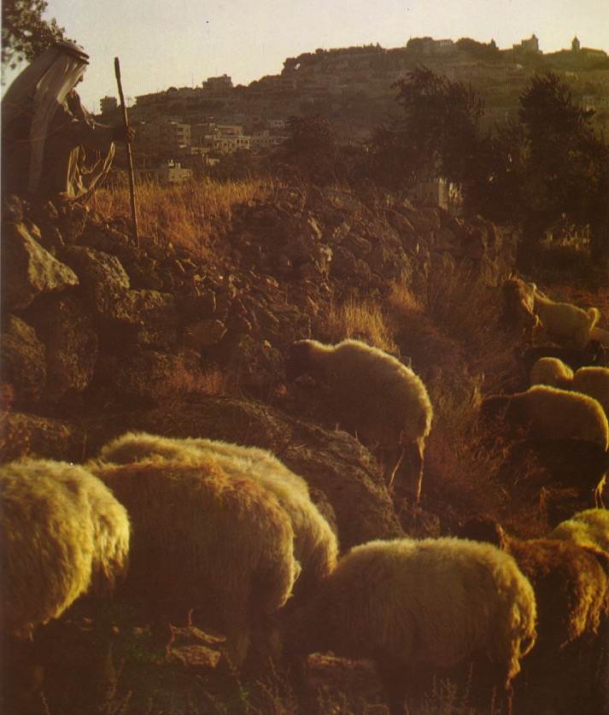
Three Reinstatements
Do you agape me?
Feed my lambs
Do you agape me?
Take care of my sheep
Do you phileo me?
Feed my sheep

Slide 23
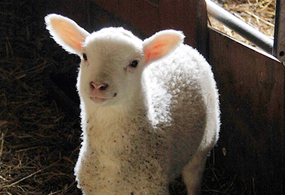
"Feed my sheep."

Slide 24
Teaching Responsibility

Slide 25
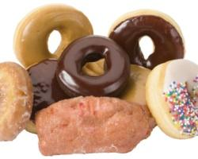
Don’t feed sheep junk food!

Slide 26
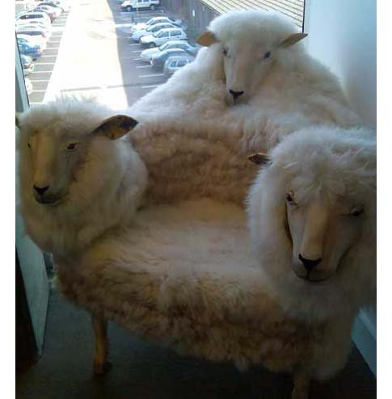
Don’t abuse sheep!

Slide 27
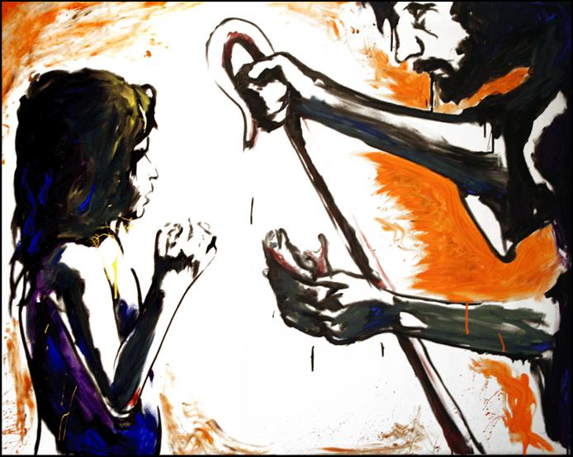
"Feed my sheep."

Slide 28
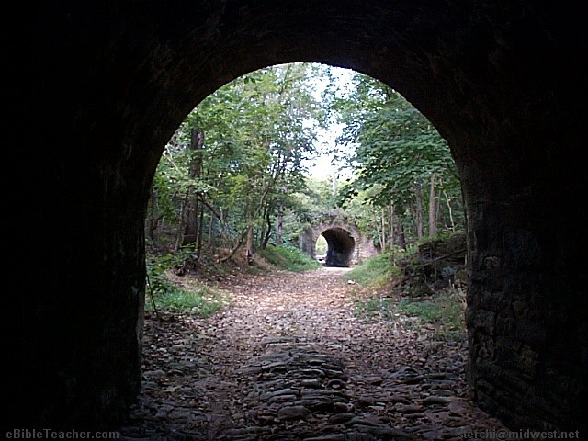
How to get Peter out of his tunnel…
Step 1: Do the same miracle again
Step 2: Reinstate him three times

Slide 29
Do You Agape Others?
Do you agape others?
I phileo them.
Do you agape others?
I phileo them.
Do you agape others?
I phileo them.

Slide 30
Our Vision is to…
Love God
Love the Church
Love the Nations
Notes:
• Love God
Where it starts—and ends—is in our call to LOVE. As Paul noted, “The greatest of these is love” (1 Cor. 13:13).
What is the most important thing we do as a church? It begins with loving the God who loves us.
• Love Church
Do you genuinely love him? If you don’t, then nothing else you do counts, really.
The second thing He said right after this: to love your neighbor as yourself.
• Love Nations
But who is your neighbor? It starts right here in the body—to love the church—but then it extends from this “close neighbor” to those who are out of the reach of this fellowship where we love the nations. Our leadership is committed to make all that we do revolve around one of these three priorities.
30

Slide 31
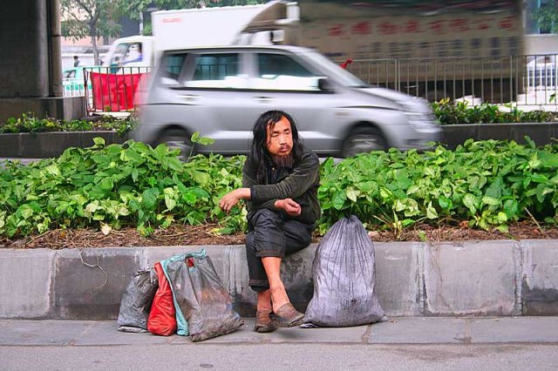
Loving people is loving Christ

Slide 32
Categories of Gifts (1 Peter 4:11)
Speaking | Serving
Teaching | Administering
Evangelism | Faith
Pastor-Teacher | Giving
Encouraging | Service
 | Mercy

Slide 33
I. Admit you need Christ even where you feel competent (21:1-14).

Slide 34
II. Show your love for Christ by loving people (21:15-17).

Slide 35
III. Don't worry about Christ’s plan for others (21:18-23).

Slide 36
“…When you are old, you will stretch out your hands, and someone else will dress you and lead you where you do not want to go” (21:18)
Peter's Crucifixion
"Follow me!"

Slide 37
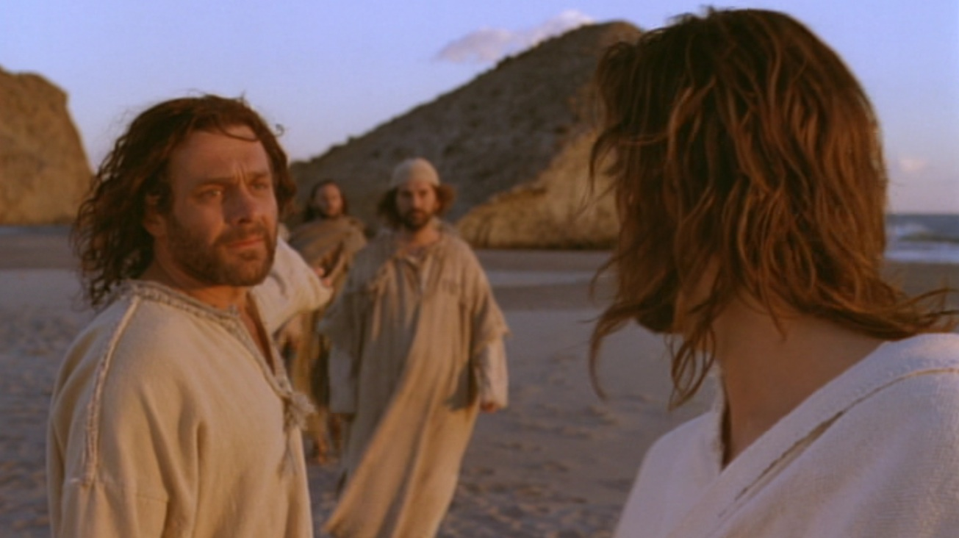
Peter asked Jesus, “What about him, Lord?" (John 21:21).

Slide 38
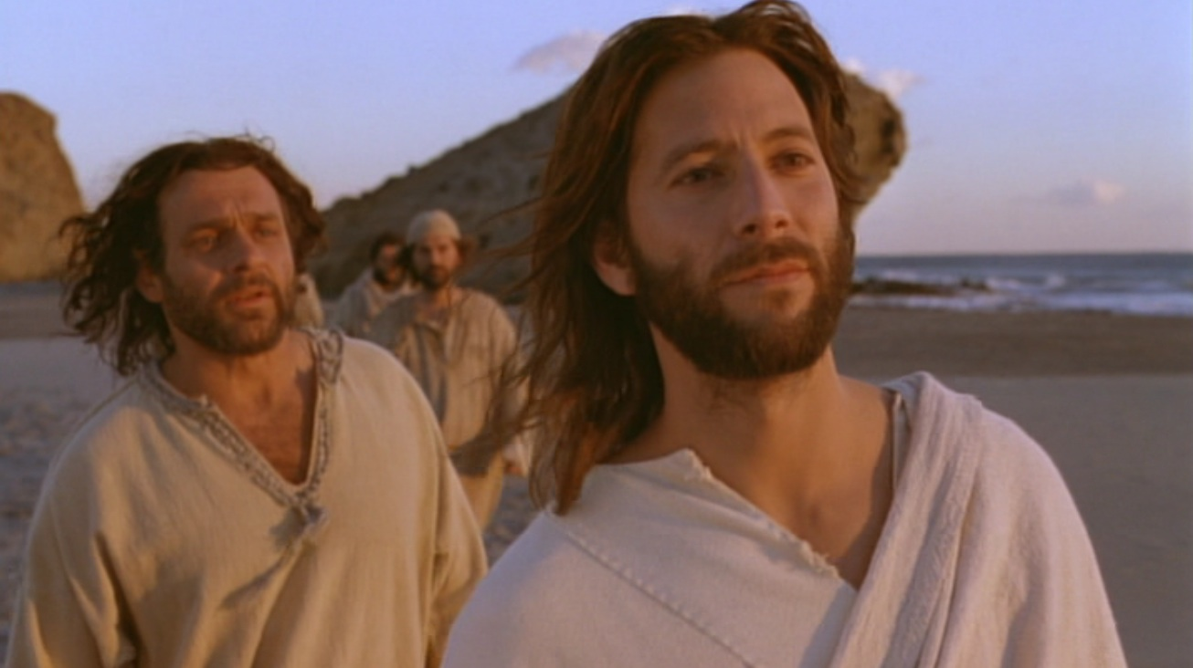
Jesus replied, “If I want him to remain alive until I return, what is that to you? As for you, follow me" (John 21:22).

Slide 39
Jesus also commands us not to question his calling for others

Slide 40
New Members Next Week!

Slide 41
Who decides when?

Slide 42
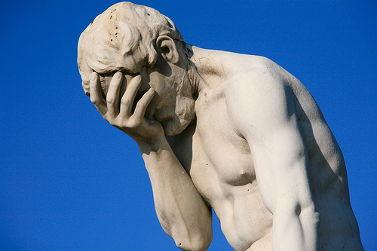
How does Jesus restore us?

Slide 43
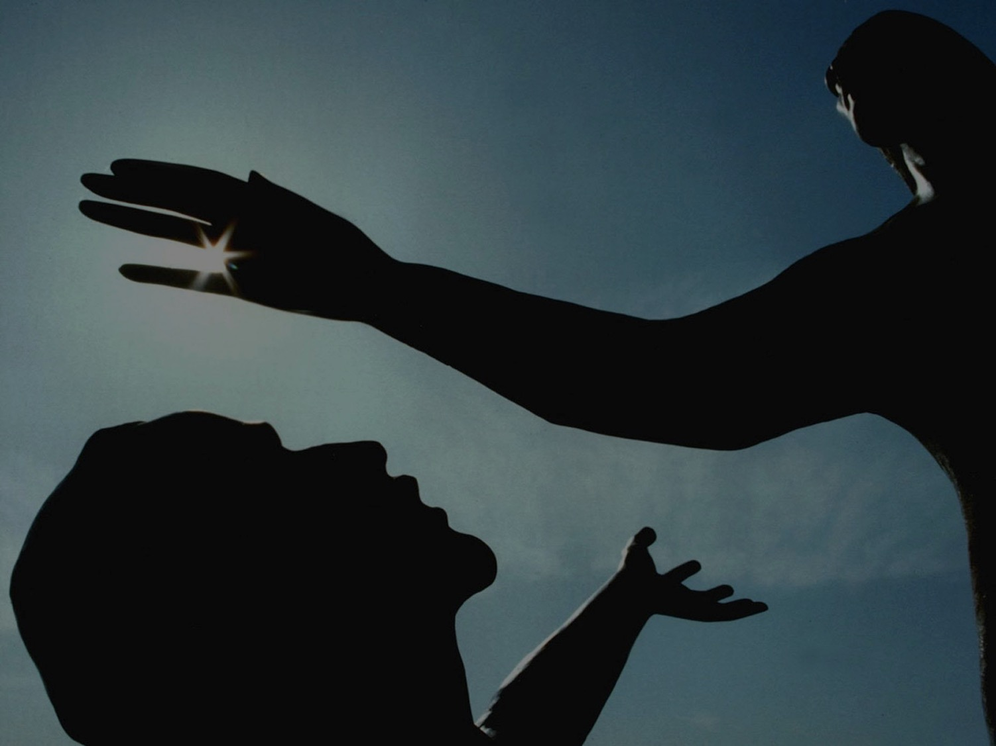
Jesus restores us to the calling He has for us!
Main Idea

Slide 44
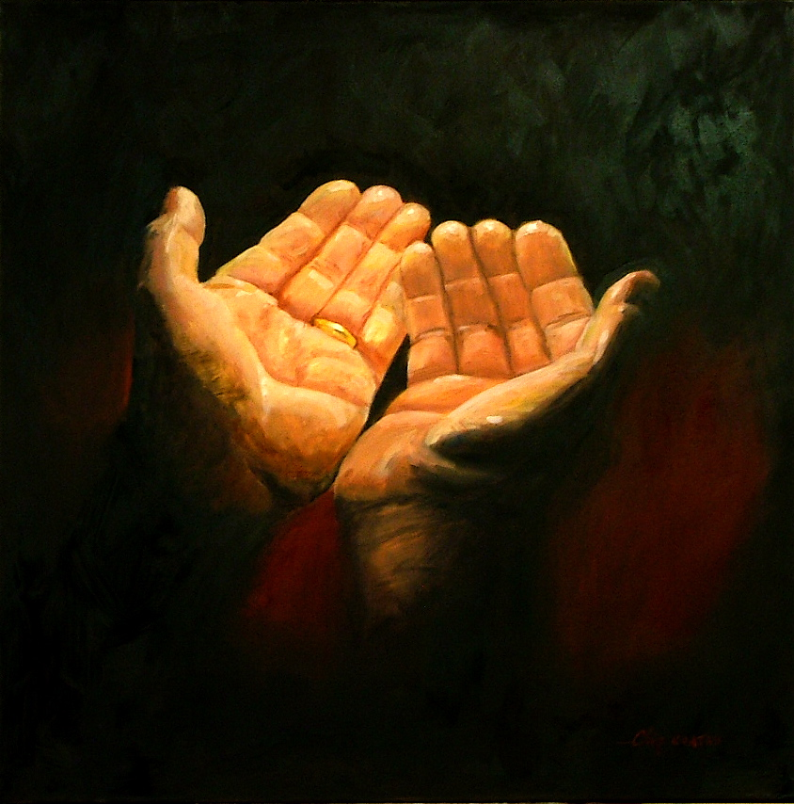
How do you find the calling He has for you?

Slide 45
I. Admit you need Christ even where you feel competent (21:1-14).

Slide 46
II. Show your love for Christ by loving people (21:15-17).

Slide 47
III. Don't worry about Christ’s plan for others (21:18-23).

Slide 48
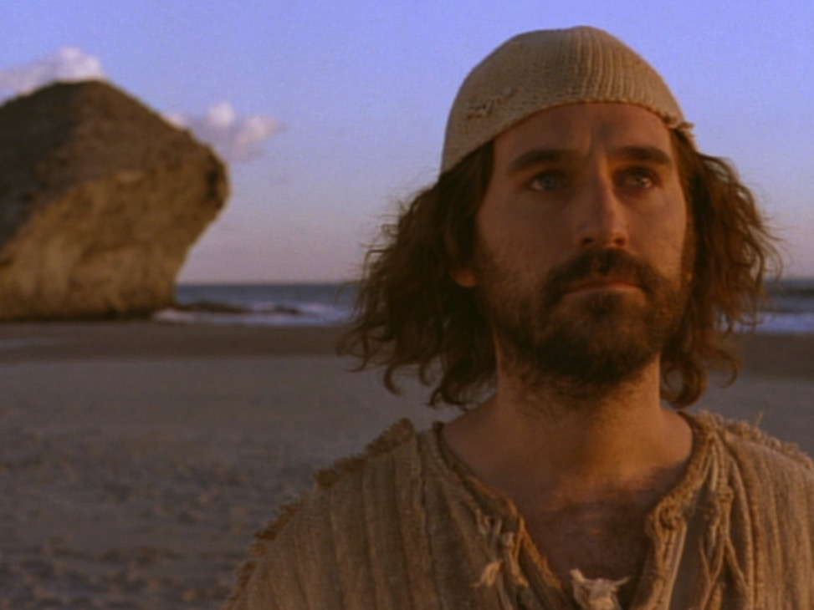
John's Conclusion (21:24-25)
“I'm an eyewitness!” (21:24)
“I haven't told half the story!” (21:25)

Slide 49
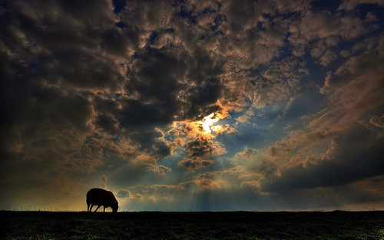
Believe in Jesus
³⁰ The disciples saw Jesus do many other miraculous signs in addition to the ones recorded in this book. ³¹ But these are written so that you may believe that Jesus is the Messiah, the Son of God, and that by believing in him you will have life by the power of his name" (20:30-31).

Slide 50
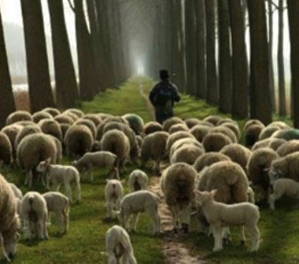
"Follow me"
"Feed my sheep"

Slide 51
Black

Slide 52
NT Sermons link at BibleStudyDownloads.org
Get this presentation and script for free!

